Slide 1

GENERATIVE AI
AUTOMATIC GUI TRANSLATION

Slide 2

KEY CHALLENGES
PROBLEM
Web applications often need to support multiple languages to reach a wider user base. consuming and costly.
This project explores the use of large language models (LLMs) for on-the-fly GUI translation
Integration
Context Preservation
Performance
Dynamic Content
Accuracy
Local Deployment

Slide 3
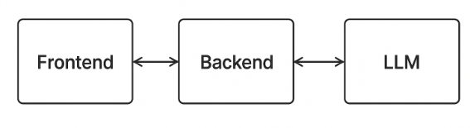
METHODOLOGY
Designing the translation module architecture.
Identifying integration points within React-based frontends.
Intercepting and replacing text nodes dynamically.
Developing a backend pipeline for model loading, inference, and caching.
Evaluating translation accuracy and speed.

Slide 4
SYSTEM ARCHITECTURE
THREE LAYERS
FRONTEND MODULE
BACKEND SERVER
AI ENGINE
JavaScript Module monitoring DOM.
Automatic detection and translation of new text nodes.
Manages translation requests and caching.
FastAPI for REST endpoints.
Local AI model.
Ollama platform with language models.

Slide 5
BACKEND FEATURES
WHY OLLAMA?
Two REST Endpoints:
/translate-one: Single text translation
/translate-many: Batch translation with streaming
Smart Caching: Stores translations to avoid redundant AI calls
Token Management: Splits large requests to respect model limits
Simplifies local LLM deployment
Handles memory management automatically
Provides consistent REST API
Supports multiple model families
Aggiungi un sottotitolo

Slide 6
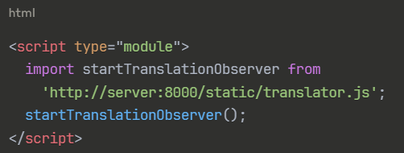

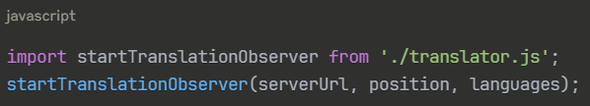
INTEGRATION
Method 1: Remote Loading
Method 2: Local Import

Slide 7
FRONTEND MODULE
DOM Monitoring: MutationObserver watches for new/changed text
Text Node Management: Dual-mapping system tracks all text elements
Smart Detection: Filters out scripts, styles, and respects "no-translate" classes
User Interface: Floating language selector with 150+ language options

Slide 8
DEMO

Slide 9
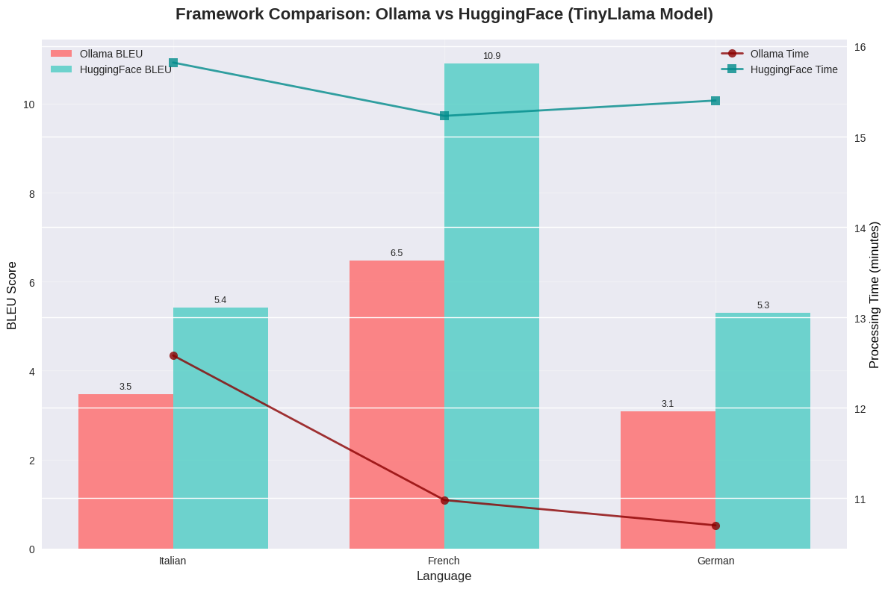
FRAMEWORK COMPARISON
Hugging Face = slightly higher BLEU, but slower.
Ollama = faster, easier deployment

Slide 10
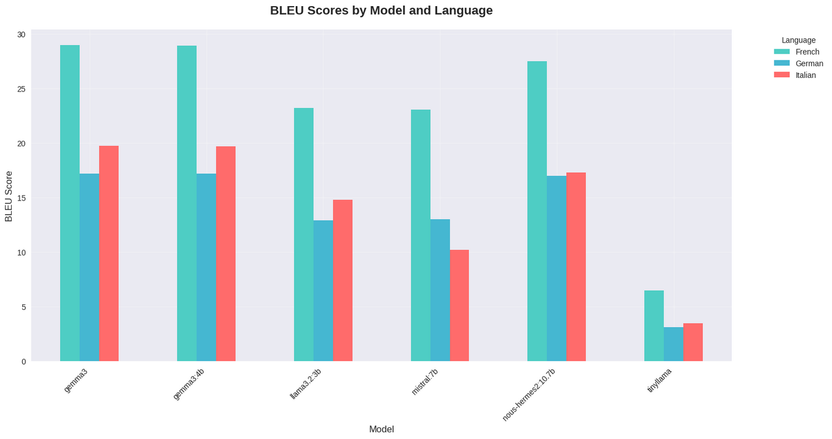
MODEL PERFORMANCE - BLEU SCORE
Gemma3 achieved the highest BLEU, especially for French (~29).
Tinyllama was inadequate (low BLEU, not much faster).

Slide 11
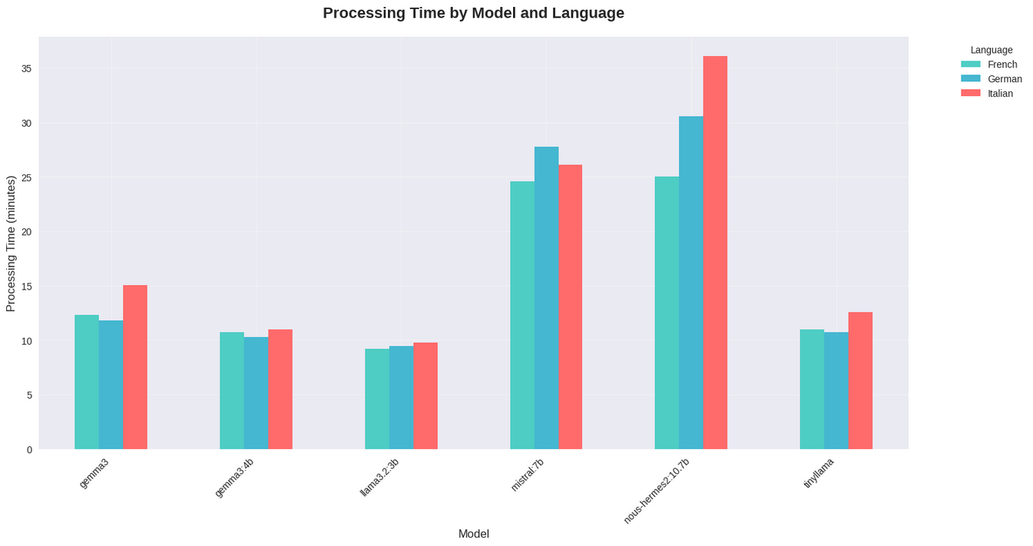
MODEL PERFORMANCE - TIME
Gemma3 → balanced quality vs time.
Nous-hermes2 → good quality but very slow (>30 min).

Slide 12
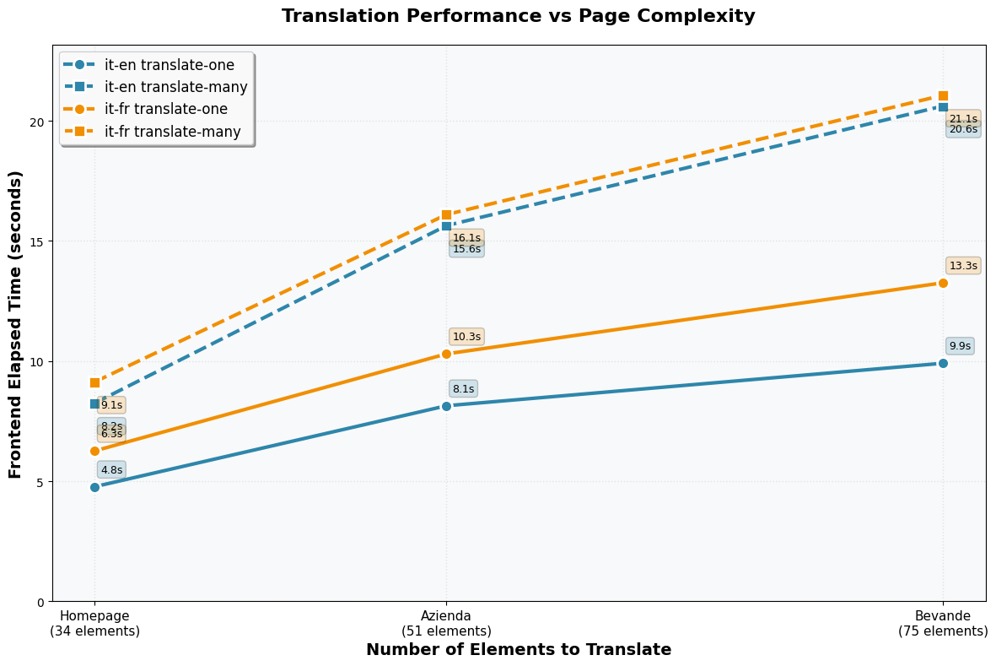
REAL-WORLD PERFORMANCE
The performance gap between methods widens significantly with page
complexity.

Slide 13
CONCLUSION &
FUTURE WORK
Conclusions:
Local LLMs are feasible for real-time GUI translation.
Ollama is preferred for efficiency.
Gemma3 is the most effective model for accuracy.
Future work:
Explore Linux-exclusive libraries (vLLM, TensorRT).
Optimize for other languages and hardware.

Slide 14
THANK YOU

